Slide 1
End of Life Project

Slide 2
Victorian Councils: Supporting Communities Around End of Life Project
Partners: MAV and Latrobe University Palliative Care Unit
3 Demonstration Projects/LGA’s
$20,000 per demonstration project
Initially focusing on the aging population, the key aims of the demonstration project were to explore, inform and develop the potential role/s and approaches of local government in building community capacity around end of life

Slide 3
12 month project
Establish a community-led group
Supported by a steering committee
Monthly meetings
Action learning
Meeting topics to be determined by the group
Opportunity for seed funding for a project
Opportunity to visit other communities

Slide 4
Key achievements
Mansfield ‘End of Lifers’ launched on Dying to Know Day August 2018
Rio’s Legacy fundraiser
December Christmas Tree of Remembrance at Mansfield library
Advanced Care Planning Forum was held during Advance care planning week in April, we had 70 people attend on the day, panel had 6 specialists from different fields, held at the performing arts centre.

Slide 5
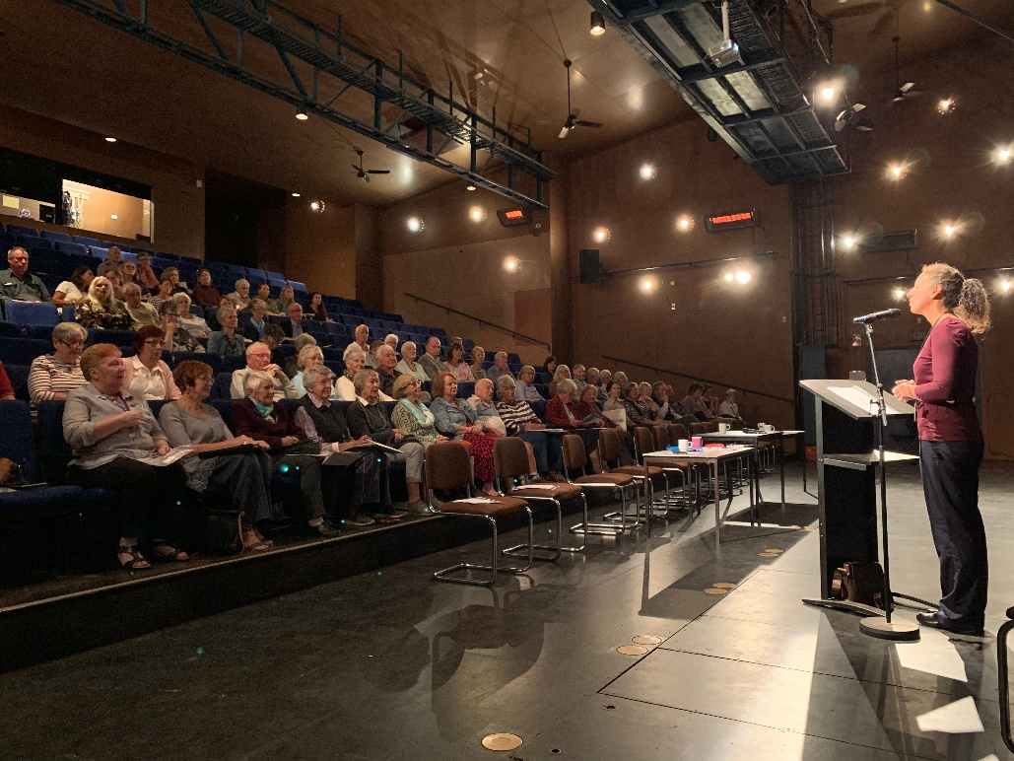
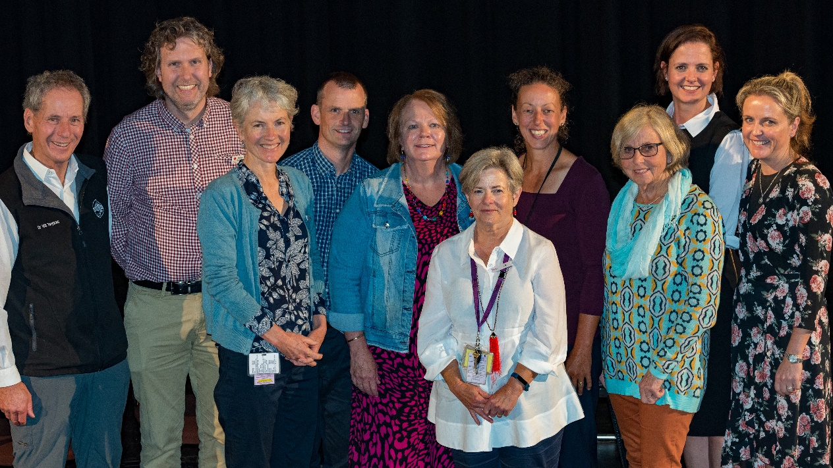

Slide 6
The Mansfield End of Lifers
Monthly meetings, average 8 participants
Panel of professionals (GP, Lawyer, cemetery trust, Funeral Director and bereavement counsellor)
Social network mapping
Death doula’s presentation
Visit by Benalla palliative care volunteers
Catch a story education session
Alternative funeral directors presentation
Celebrations

Slide 7
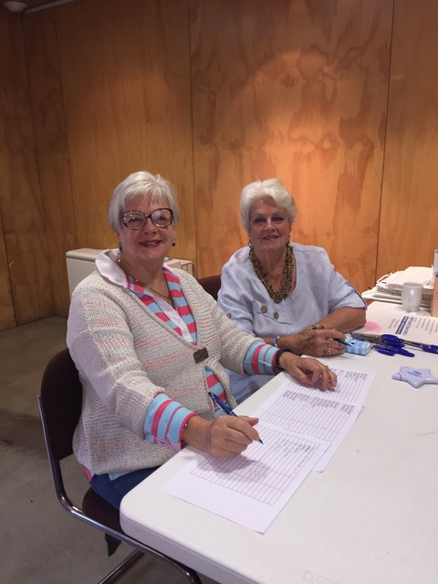

Slide 8
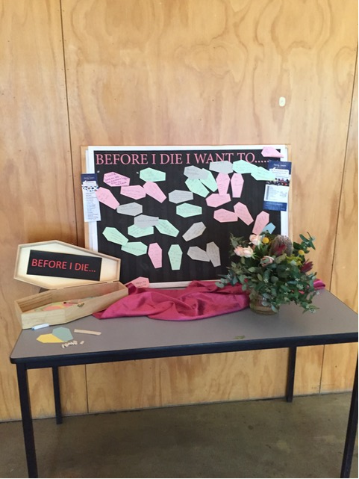
Mansfield Shire Council
Dying to know board.
Staff morning tea
Participation in Steering Group and support of group

Slide 9
What we learnt
Opportunity to work across two areas of Council was beneficial for expanding skills, sharing knowledge and growing networks
Language around ‘End of Life’ needs to be considered and can be a barrier
Input from professionals (the steering committee) was integral to the success
Community Development takes time

Slide 10
Where to from here
Life’s Circle – Lets Talk About It.
Mission Statement: To encourage and support people, of all ages, in our community to converse about how we can celebrate the cycle of our lives from birth to death.
Auspiced by Rosehaven
Calendar of events/activities to provide opportunities for the community to converse
Annual Christmas Tree of Remembrance
Bi-Annual Advanced Care Planning Forum
Intergenerational project ‘the talking couch’ (early 2020)
Partner/build on key dates for example Seniors Week, Pallative Care Week, Mental Health Week
Dying to Know Day 2019

