Slide 1
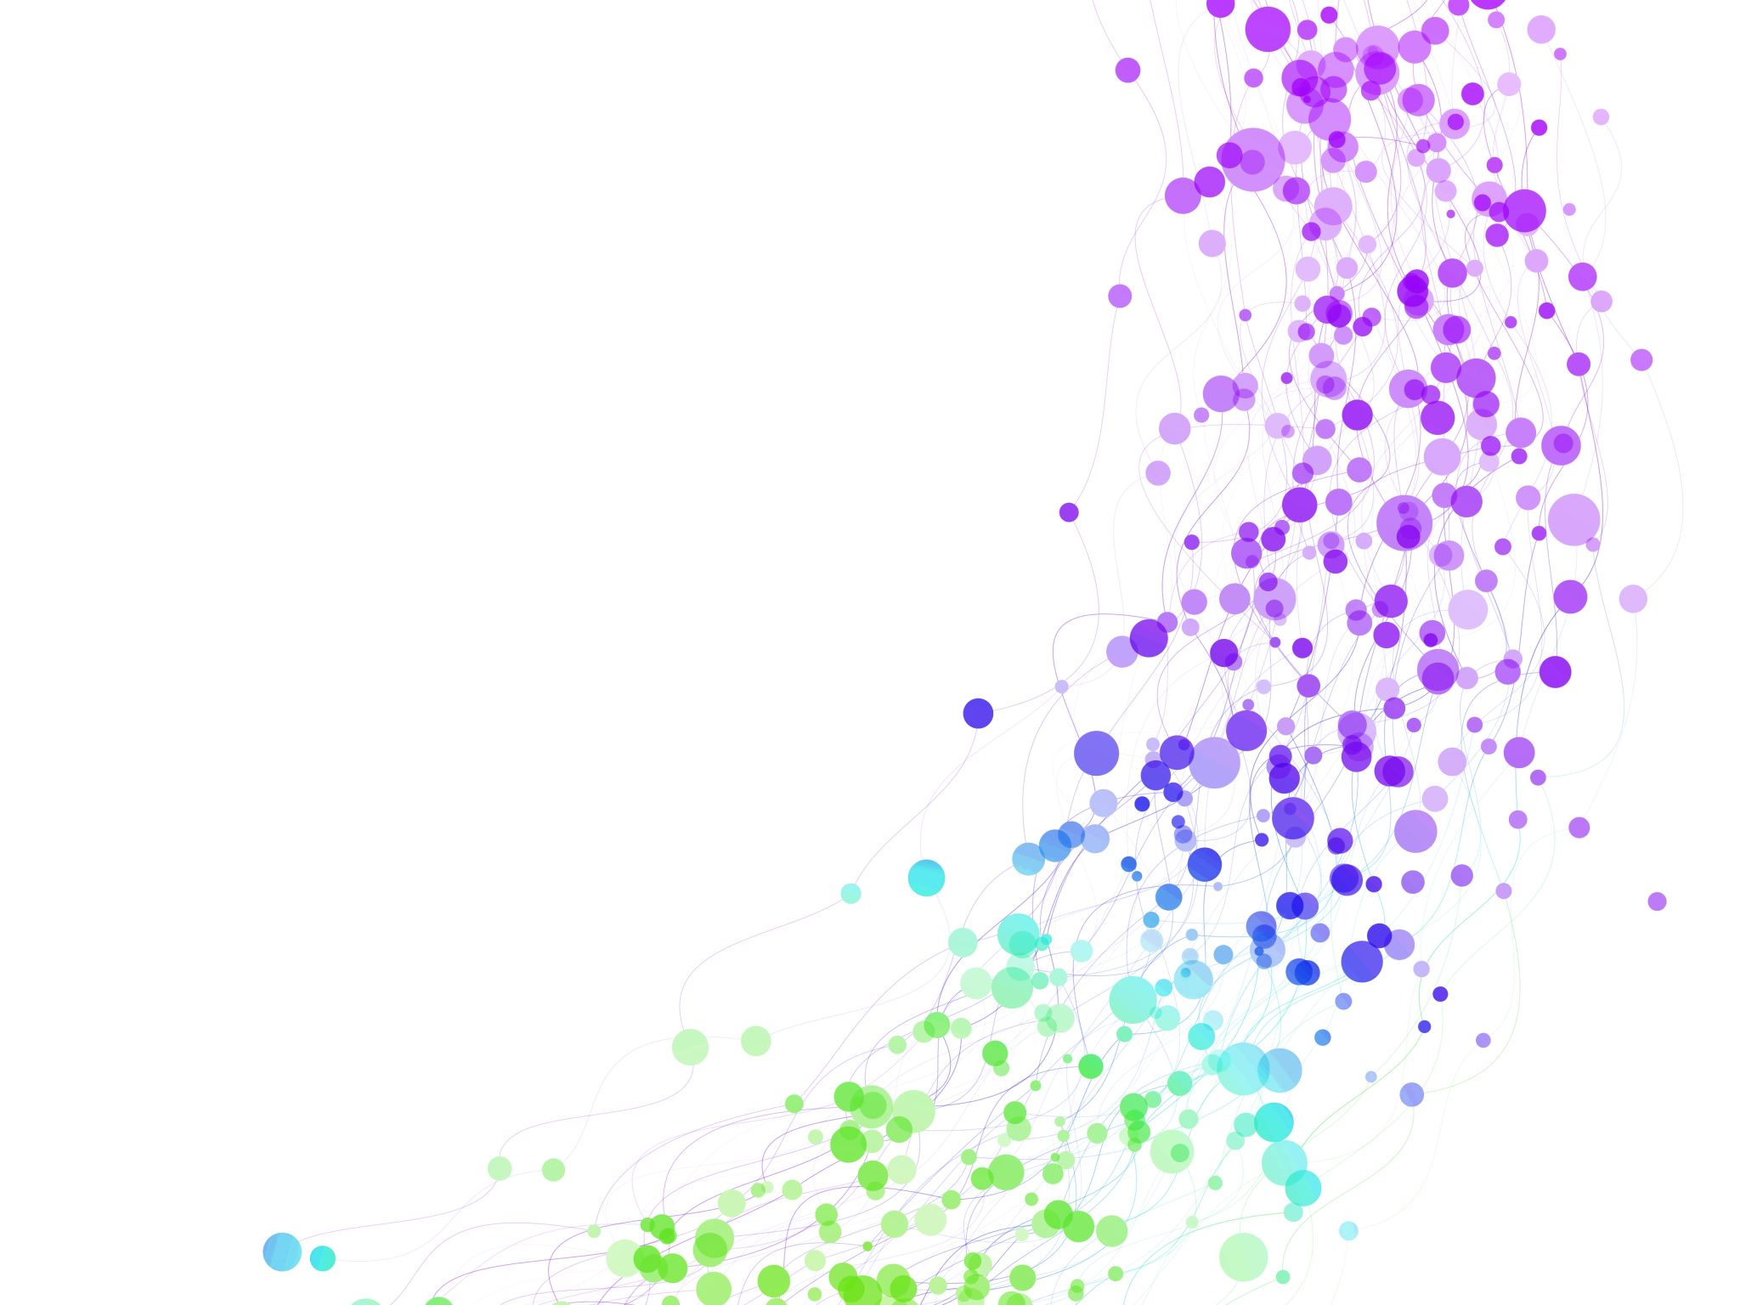
Child Development Information System (CDIS) CDIS User Group – Clinical
August 2024

Slide 2
Agenda
Tips & Tricks
Edit Bar
Key Age and Stages Age Ranges and CDIS
Family Consult & MARAM Data
CDIS: Discharge Summary Process
Practice Note - Client Correspondence & CNP
Q&A

Slide 3
Tips & Tricks
Using Edit bar to alert MCHN that discharge summary has been attached.
Always remember to date and initial.
Always remember to delete once not required.

Slide 4
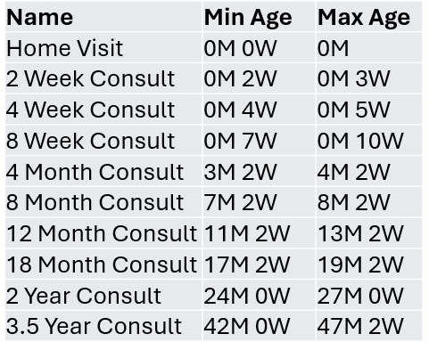
KEY AGE and STAGES in CDIS
CDIS does not prevent users from creating client appointments, based on KAS age ranges.
This is true for scheduling or delivering any KAS consultation earlier than the min age range specified.
This is true for scheduling or delivering any KAS consultation later than the max age range specified
Important:
Remember clinical age for certain assessments eg MIST up to 4.5yrs

Slide 5
Family Consult and MARAM data
Revisiting the Family Consult and MARAM data from last CDIS User Group:
Annual report summary results
The family violence consultations are counted regardless of whether they are completed for the PCG or the child.
The family violence MARAM Assessment tool is counted, regardless of whether it is completed for the PCG or the child, as per the criteria ‘Family violence is identified’ meaning that the first question must be answered YES for the MARAM Asst. tool to be counted.
The Safety Plan MARAM Assessment tool is counted, regardless of whether it is completed for the PCG or the child.

Slide 6
CDIS: Discharge Summary Process
Reference group have reviewed and updated the CDIS: Discharge summary Process to now include guidance regarding recording of discharge weight.
Link: https://www.health.vic.gov.au/maternal-child-health/child-development-information-system
Key message:
MCHN to read prior to HV
Attach to CDIS record (can be attached by admin team)
Record discharge weight and date into CDIS following the last weight recorded from maternity service eg Dom, PACU, HITH
Notes:
Reminder that the Discharge Summary is always attached to the infant’s record as the birth details etc. relate to the baby.

Slide 7
CDIS: Discharge Summary Process

Slide 8
Practice Note: Client correspondence & Client Not Present feature on CDIS
Reference group have created this practice note to guide how to document client correspondence in CDIS and how to use the CNP screens.
Client correspondence includes SMS, phone calls, emails, and reports and must be recorded in CDIS to maintain an accurate and complete health record.
Best practice is to copy SMS and emails in full when recording into CDIS.
Best practice is to also attach reports and emails to CDIS history.

Slide 9
Client Not Present – preferred method of recording client correspondence
This ensures notes are recorded in the client history where the CNP is recorded.

Slide 10
Client Not Present – preferred method of recording client correspondence
If the notes recorded in CNP are relevant to another family member these notes will need to be copied into that family members notes.
Note: MCH staff need to be aware of the Information Sharing Legislation and the use of CNP screen for this process
Note: MCH Administration teams can attach documents to CDIS records and then forward correspondence to MCH Leadership or clinician.
All Cancelled/rescheduled appointments should be recorded in the appointment.
Admin recording in CNP will be the exception rather than the rule e.g. further detail regarding disclosures made in communication with parent/carer.
Communication from administration teams to clinicians is essential to ensure appropriate client service. E.g. emailing/calling clinician regarding EMCH client contact.
https://www.health.vic.gov.au/maternal-child-health/child-development-information-system

Slide 11
Client Not Present Process
Notes:
The practice note walks through the process of recording a CNP.
Service date and time is automated
Program – if EMCH or S&S select
Agency – best practice is to complete
Service type – mandatory field – see next slide
Location – not mandatory but can be completed
Others involved free text field
Professionals involved – if linked to the client's record
Notes – Comprehensive notes - include the name and contact details of who is involved.
Time – record as approrpiate

Slide 12
Service Type | Usage
Referral | Used when a referral has been generated
Case Conference/discussion | For when the client is not present at a formal /planned professional discussion regarding a specific client or program (including Integrated Programs)
Data adjustment | Record time missed in previous consultations especially for integrated programs eg EMCH groups.
Reports | For attaching reports received from other agencies (CP, Family services), or when writing a report pertaining to a client or program.
Telephone Consultation | For conversations with clients. If the conversation becomes a consultation, please record as an additional consult – location as telephone consult.
Email | For email correspondence pertaining to a client or program. Includes correspondence from the client and to the client. In the Notes Section copy email or write See attached email and report attached. Save email as an attachment – see your IT dept for process. This ensures a complete health record.
SMS | SMS correspondence pertaining to a client or program. Includes correspondence from the client and to the client. Copy SMS and email to clinicians’ email address. Copy and paste SMS (emailed) into CDIS Client not present notes. Best Practice to include the clinicians phone number that sent the message and the clients phone number where the reply originated from. Save email as an attachment- See your IT dept for process.
Follow-up | Sending letters; recording what additional work was done following DNAs; any other follow-up activities related to a client or program. Can be used for secondary consult with colleague or MCH Leadership. It can be used for a range of different activities, including when no other service type is suitable.
Information Sharing - Making a request | Only to be used when meeting the requirements of the Child Information Sharing Scheme and the Family Violence Information Sharing Scheme All IS requests and responses to be saved in notes section of client not present and attached if email or document. Recording of informal information sharing with prescribed ISE to also be recorded as Proactively Sharing
Information Sharing - Receipt of requested information
Information Sharing - Receiving a request
Information Sharing - Responding to a request
Information Sharing - Proactively Sharing
Information Sharing - Update to Responder Post Sharing
Migration - EMCH | No longer in use
Notes:
CNP – Service Types and process

Slide 13
CNP Tips
Please note that the Did Not Attend (DNA) must be completed in the calendar if a client does not attend an appointment.
However, you may add additional information by completing a CNP if you have undertaken a more extensive follow-up after the DNA.
The follow–up may relate to additional work that the clinican has done to assist a client and may include advocacy for the client, or the client has multiple DNA’s and additional work is required.
Best Practice with multiple SMS messages is to ensure the SMS trail is complete and enter these in the Notes of the Client Not Present prior to saving. See snips

Slide 14
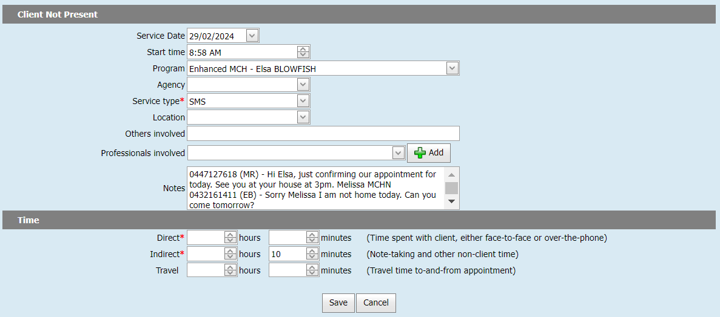
Image 6 – Enter the complete SMS correspondence, within the Notes of the Client Not Present Screen
Notes:
Note the phone number and initials of clinician and carer are recorded for SMS.

Slide 15
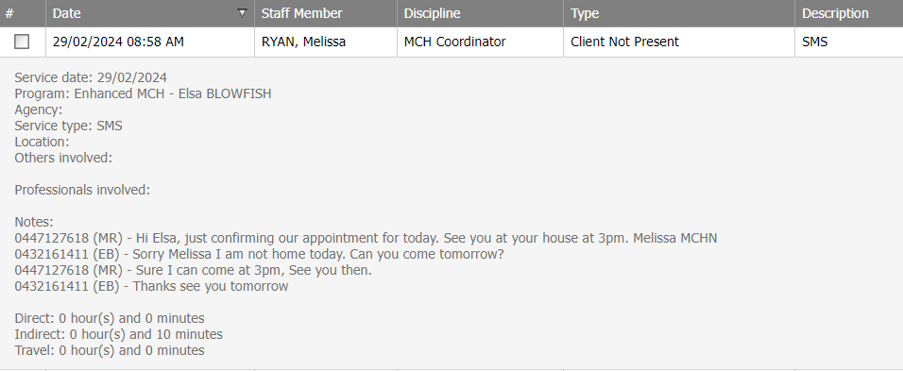
Image 7 – Client history contains the complete SMS correspondence
Notes:
SMS trail – do you know how to send the SMS to your email address then copy and paste into CDIS?

