Slide 1
CDIS User Group - Clinical
Tuesday 11/02/2025
CDIS User Group – Clinical Feb 2025

Slide 2
Agenda
Role of CDIS Champion
Open/Change/Close
When to close a record
Relationships
Addresses
Transfer of EMCH / S&S clients
Plus, sign
External referrals
Update current home site
CDIS Support
Q&A:
Recording surrogacy or adoption.
Removing from BN List
CDIS User Group – Clinical Feb 2025

Slide 3
Role of the CDIS Champion
Representing your team.
Resource in your team for CDIS education, questions and troubleshooting.
Note any common themes or questions from your team to report to the group.
Gather information from your team to be addressed in the User Group meetings or followed up by the CDIS Reference group and highlight education needs.
Attend User Group meetings every 6-8 weeks.
Contribute to User Group meetings conversations re your teams CDIS practice, questions and ideas.
Sharing information learned at the CDIS user group meetings with your team ie regular CDIS update presentation at team meetings
Prompting your team use of CDIS resources such as the vimeo’s and CDIS education through the Help & Support tab on CDIS.
CDIS User Group – Clinical Feb 2025

Slide 4
Open/Change/Close
Client records should be OPEN for Universal service, which means they are active or receiving maternal and child health service (previously referred to as enrolled)
Who should be open:
• All children eligible for MCH service (up to school age)
• All Primary Caregivers
MCH activity is recorded at the service it occurs for reporting. Data is not affected by transfers of clients.
Funding is based on number of open records/enrolments as reported in the annual report at the end of financial year (2E). Based on population not activity.
CDIS User Group – Clinical Feb 2025

Slide 5
When to Close Records
When a child dies/stillborn
When a child moves permanently overseas
When a child moves permanently interstate.
Even though we are a voluntary service, MCH services should be proactive and offer “assertive outreach”, example if a client says declines MCH support, we encourage a response such as “Are you happy if we contact you periodically to check in and see if you would like a key age and stage visit at a later stage”.
If a client adamantly declines service, add an edit note “Client declining service”, untick the consent for contact in the client details screen but leave them “Open”. There are examples of clients who have declined service in past, making contact for review when child is older, the KAS consults have then been conducted in closed records and have not been counted in reporting or included in numbers for funding.
Closed clients will also not appear on Missed visit reports. But older children open to service who have not had a KAS visit will be appear on reports.
CDIS User Group – Clinical Feb 2025

Slide 6
Relationships
Under client details
Client relationships – important that these are always kept up to date
Family relationships must be added from this screen
Perform a statewide search and use the correct record if found, do not create a new record if not needed.
Every child should have at least one contact that is a primary care giver
https://vimeo.com/432021489 - CDIS education video that will step you through the process.
Only Primary Care givers or Caregivers of children should be ticked as information sharing in a child record.
Ensure “contactable” is ticked if you want to be able to send SMS to the PCG or care giver.
CDIS User Group – Clinical Feb 2025

Slide 7
Addresses
Current address is important to maintain the integrity of a medical record.
A medical record must contain all previous addresses to help identify the client.
Tip – ask caregivers if they received the sms reminder to check current contact details.
CDIS User Group – Clinical Feb 2025
Notes:
A history of addresses can help to identify the right CDIS record

Slide 8
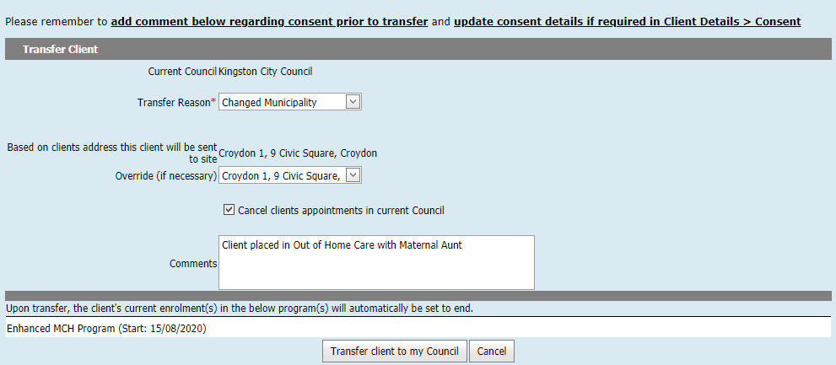
Transfer of EMCH / S&S client
CDIS User Group – Admin Feb 2025
Notes:
Careful note should be taken when transferring adults that have a current enrolment in an Enhanced or S&S program as these programs will be closed and information can get lost when transferred.
Cut and Paste the Program information into the comments before transfer of the record.
Best practice would be to have the MCH team leader contact the relevant council prior to transfer.
Best Practice is to always pull histories, never “push” or transfer a file away from your council.

Slide 9
Remember the importance of the button
Clinicians must always click on the Green add / Plus button when recording:
Counselling
Additional needs
Referral reasons
If not used:
The details/notes will not be added to the CDIS record and therefore not available for the next clinician.
Referrals will not be correctly completed
No data recorded therefore will not be included in annual report.
There is no fail safe that stops you from proceeding without clicking the green add button
CDIS User Group – Clinical Feb 2025

Slide 10
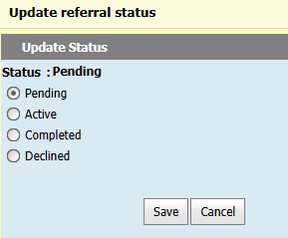
Referrals
When searching for a referrer:
In Organisation field, type “generic”, and click search (next slide)
A list of generic referral types will appear; choose one
External referral should still be completed in CDIS, if the agency has their own referral form. Example description to type in text the box “See attached referral to Community Health – Speech.”
After saving the referral, the referral Status should be updated by clinician, from Pending to Active, in the client's referral screen, and then to Completed once acknowledged (or Declined if notified by service)
CDIS User Group – Clinical Feb 2025

Slide 11
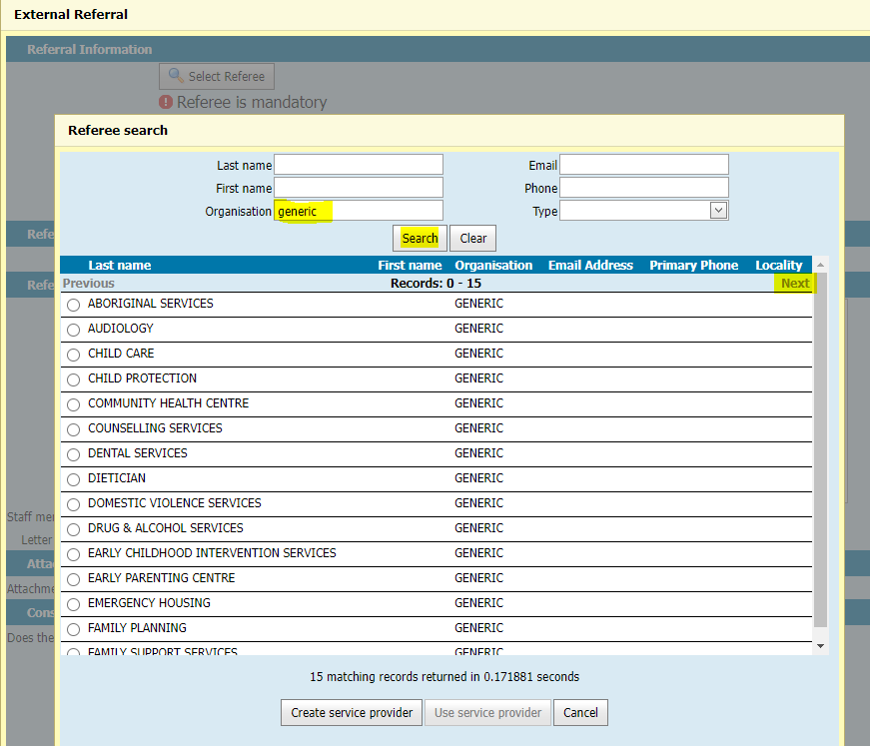
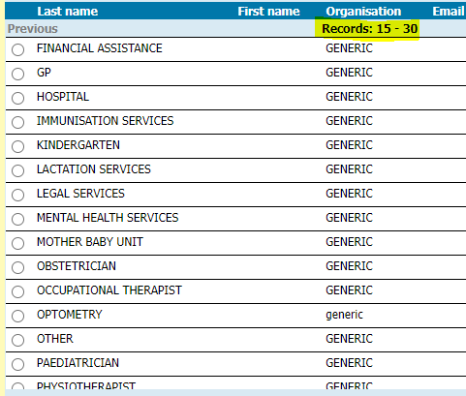
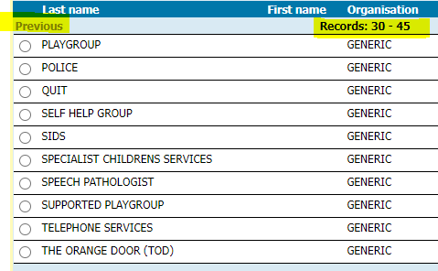
CDIS User Group – Clinical Feb 2025

Slide 12
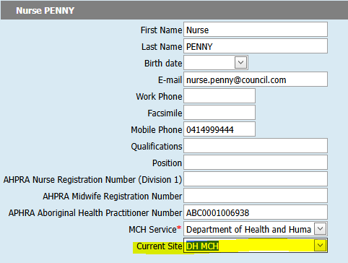
Update Current (Home) Site
If working from a different diary or site in CDIS, you can change your current site.
On the Home page, select menu User Settings > Update Details
Click Current Site drop-down list and select the correct site.
Click Save at the bottom of the screen.
The default site on the Calendar screen will now be updated.
Note: you do not need to change a client's home site if they temporarily visit another site for their appointment.
CDIS User Group – Clinical Feb 2025

Slide 13
CDIS Support
Before contacting CDIS Support with issues or questions:
Discuss with a Clinical Coordinator, Team Leader or CDIS Champion. Many issues can be solved swiftly by your team.
Are you the only one with the issue or are others experiencing this too? When was this problem first noticed?
Any technical issues e.g. printing, connecting to CDIS, do others have an issue? Check with your IT team if there is a network issue, or an issue affecting your device.
Check the online resources available from the CDIS Home page > Help & Support menu.
CDIS User Group – Clinical Feb 2025

Slide 14
CDIS Support (continued)
If your local resources cannot assist, and your issue or question remains, contact CDIS Support on 1300 856 183 or cdis@support.vic.gov.au and include:
Confirmation you have first asked a Clinical Coordinator, Team Leader or CDIS Champion and / or local IT.
A summary of the question or issue, and if it is affecting others also.
What screen are you using? Provide a screen capture of the error and copy and paste the screen URL (web address).
What actions / steps are you doing in CDIS? (this helps to reproduce an issue)
What is the outcome you’re expecting vs what is actually happening?
Client ID (this is essential to investigate client related issues)
For reports, also include the name of the report, include the data range, and any other data selections. If you can , supply a copy of the report . Leave CDIS ID’s but you can remove personal information such as DOB, name etc, and list what you have removed along with the report and the issues you’re experiencing.
CDIS User Group – Clinical Feb 2025

Slide 15
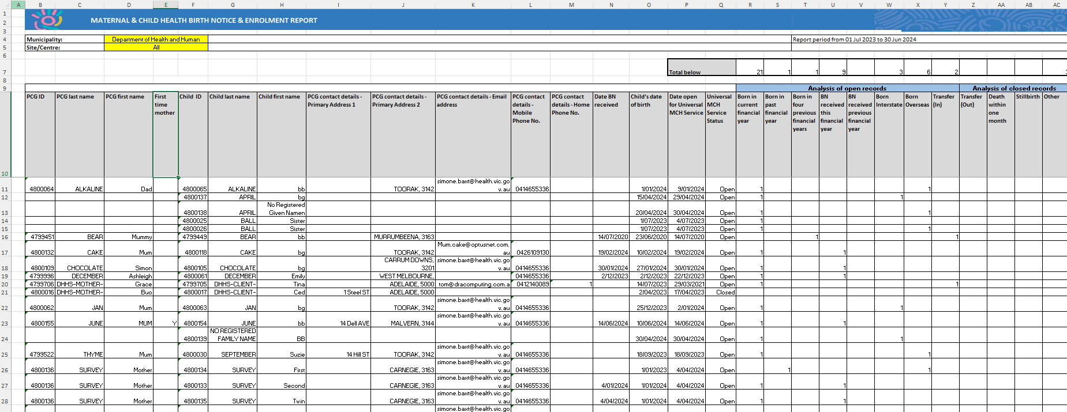
CDIS Support (continued)
This is an example Birth Notice and Enrolment Report.
CDIS User Group – Clinical Feb 2025
Notes:
Example Birth Notice and Enrolment Report

Slide 16
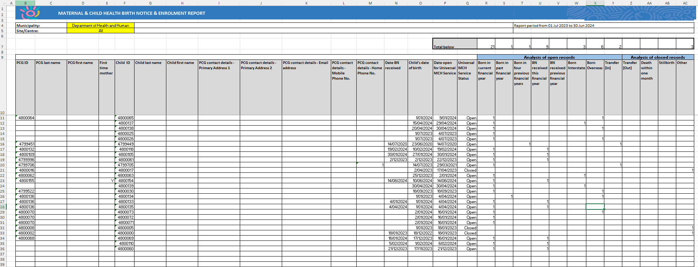
CDIS Support (continued)
You can highlight and remove the data in columns C and D, and G through and including L.
CDIS User Group – Clinical Feb 2025
Notes:
Example Birth Notice and Enrolment Report

Slide 17
CDIS Support (continued)
CDIS Support Hours
Monday to Friday between 8:30am to 5:30 pm
Contact
1300 856 183
cdis@support.vic.gov.au
CDIS User Group – Clinical Feb 2025

Slide 18
Recording of Surrogacy or adoption on CDIS
How do you remove child from the Birth Notification List

Slide 19
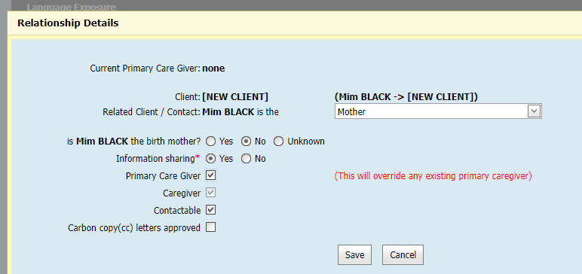
What if the baby is adopted or part of a surrogacy arrangement.
Please tick adoption box if relevant in demographic data.
When adding relationships add birth mother, she may already be open if she has other children in the service otherwise open her for service as she may require post natal care and then close when she completes the care.
Then when adding the non biological mother and open for service ensure that you have ticked non birth mother but add as mother:
CDIS User Group – Clinical Feb 2025

Slide 20
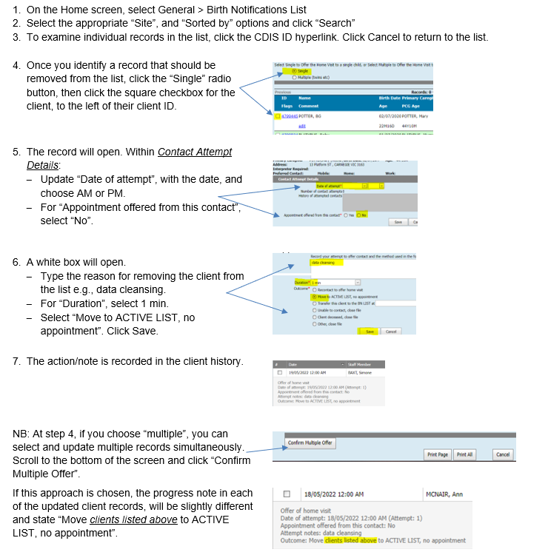
Checking & Removing client records in the Birth Notifications List
CDIS User Group – Clinical Feb 2025

