Slide 1
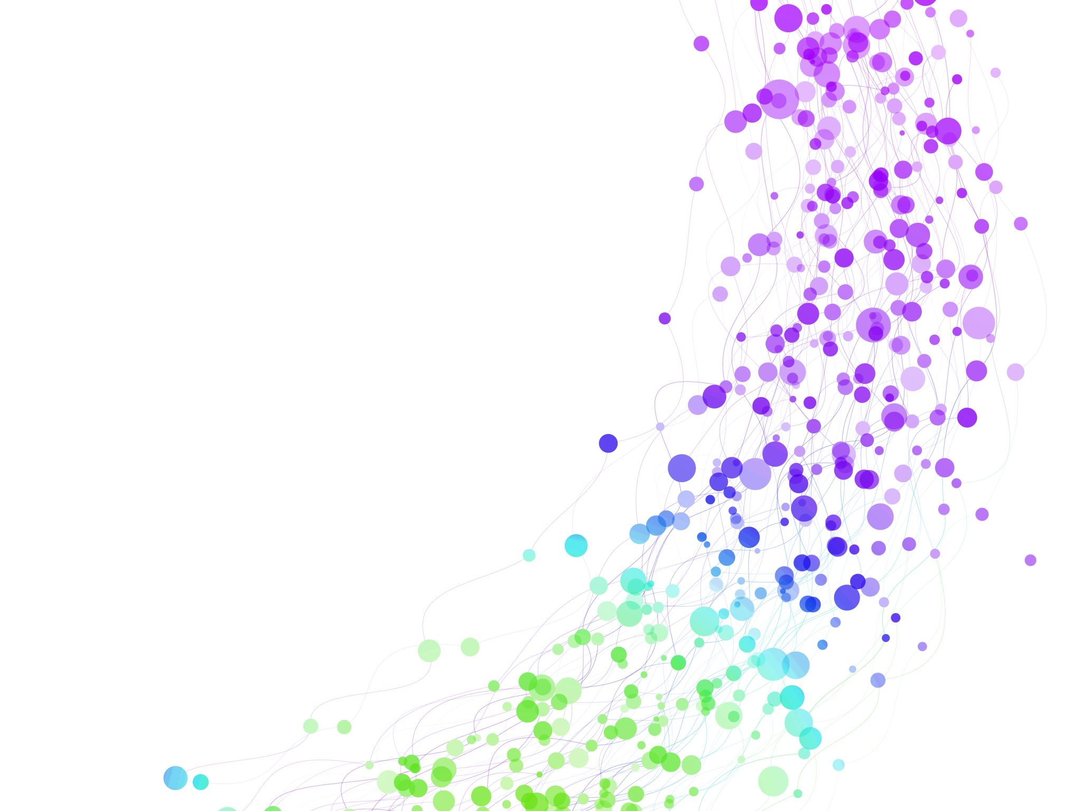
Child Development Information System (CDIS) CDIS User Group – Clinical
October 2024

Slide 2
Agenda
Tips & Tricks
Bulk SMS reschedule
External Referrals
CDIS KAS Overdue Age Ranges
Assessment Tools
Pregnancy & Delivery screens
Transfers
Q&A

Slide 3
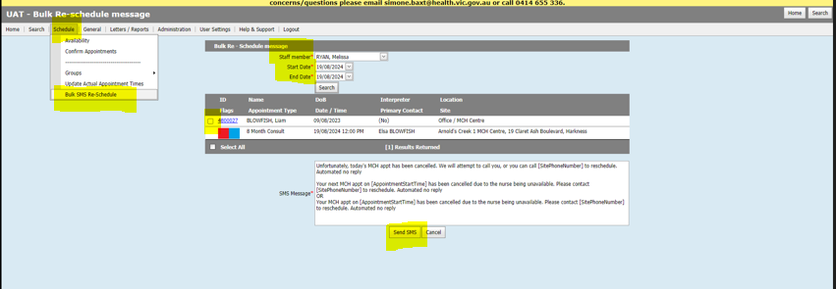
Tips & tricks
Bulk SMS Reschedule Process:
Select Bulk SMS reschedule
Add clinicians name and date
Select the clients using all to receive SMS.
Cross check against calendar to ensure you are sending the SMS to the correct clients.
Any clients that are not on the list may have no clinician or the wrong clinician allocated to the appointment.
Notes:
Need to ensure relationships are set up correctly and need a process for interpreters.

Slide 4
Tips & Tricks
At the beginning of MCH consult MCHN asks the client
“Did you receive the SMS message about today's appointment?”
This will help to see if the CDIS reminders are working or if we need to update the contact details

Slide 5
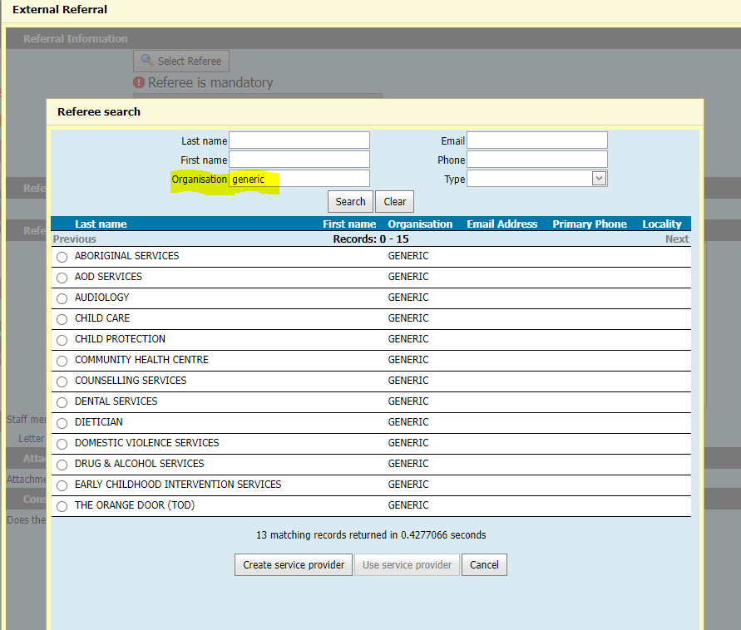
External Referrals – Use Generic
Notes:
Use generic in the organization look up

Slide 6
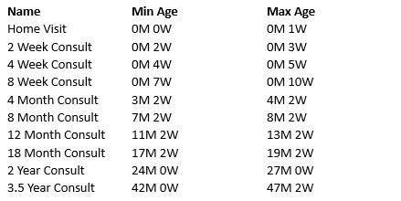
CDIS KAS age ranges
Always ensure you are in the correct KAS consult for the child's age
In CDIS, these are KAS age ranges for the system to identify overdue KAS
CDIS does not prevent users from creating client appointments, based on KAS age ranges
A client is considered overdue for a KAS (in CDIS) if they are older than the max age for that KAS AND younger than the minimum age for the next KAS.
Notes:
All children are eligible for 10 KAS appointments.

Slide 7
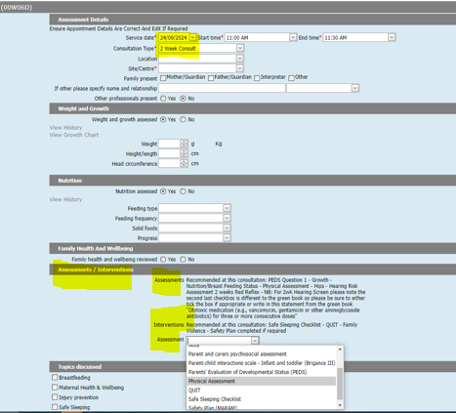
Using the assessments prescribed within a KAS
Best practice is to complete the prescribed assessments at each KAS.
This will also impact your services data collection.
Notes:
We are hearing inconsistencies in how and if the assessments are being used – best practice is to complete the presecribed assessemnts.

Slide 8
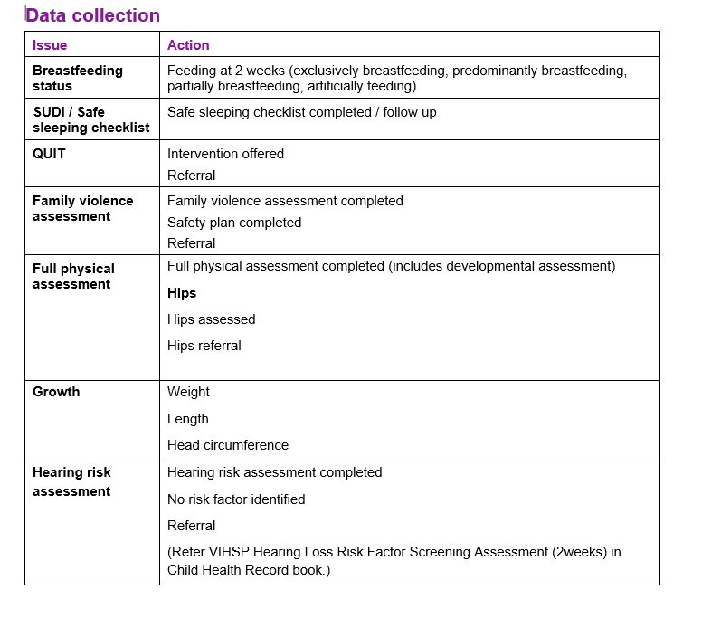
MCH Practice Guidelines – KAS data collection
Maternal and Child Health service play a key role in improving outcomes for children and their families
The MCH KAS framework identifies the outcomes, and the measurable indicators associated with outcomes.
The Practice Guidelines outline the key assessments and interventions required at each KAS.
CDIS reflects this in the Assessments/Intervention section
eg 2wk KAS in table opposite

Slide 9
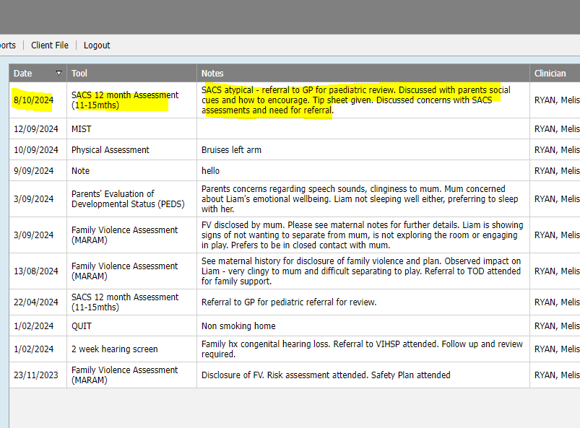
Assessments and Comments fields
Practice note: Add NAD or notes as required

Slide 10
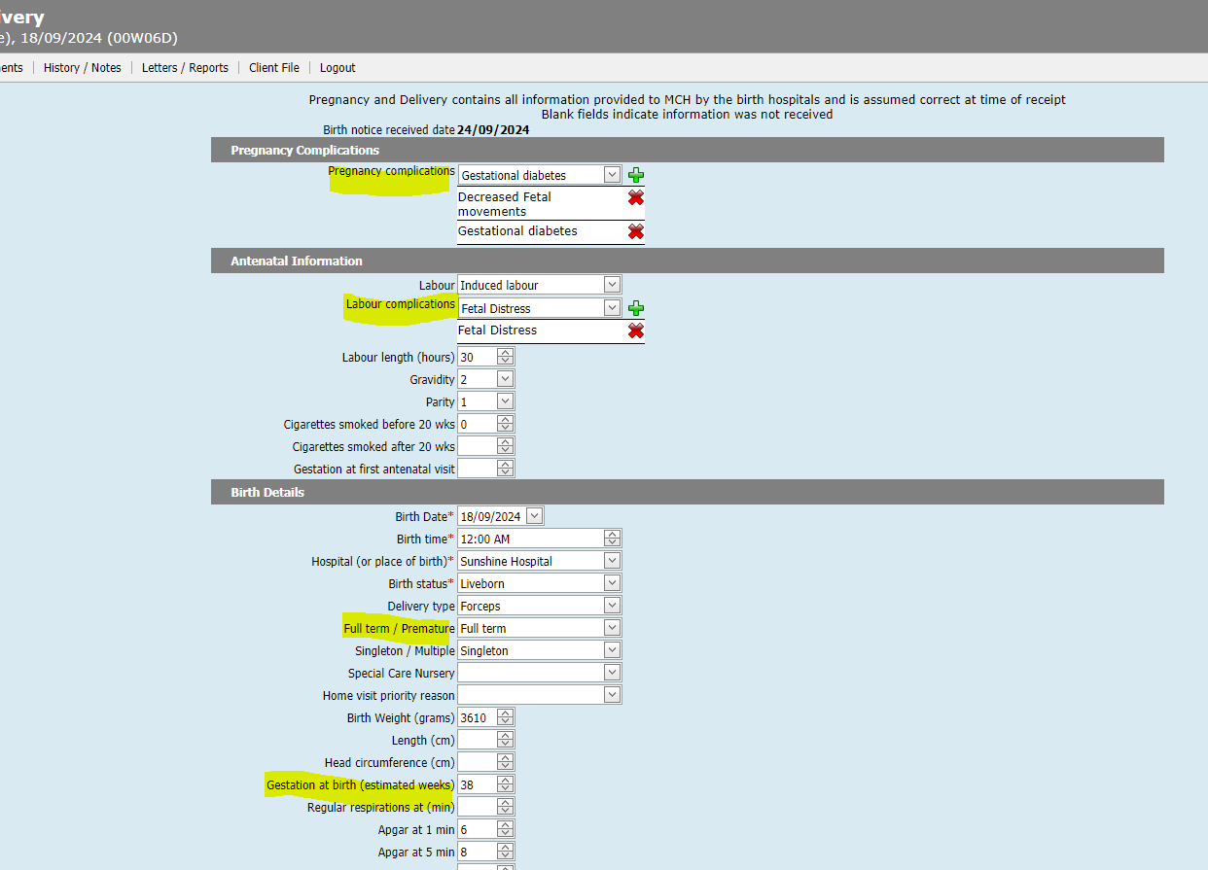
Pregnancy & Delivery Details
Best practice is to complete these fields.
Even when an older baby/child is transferred into your service, and they are not completed.
You can only complete with the information you have available eg if babe born overseas – limited information may be available.
Notes:
Clarification regarding this was requested at the Leadership reporting CDIS session

Slide 11
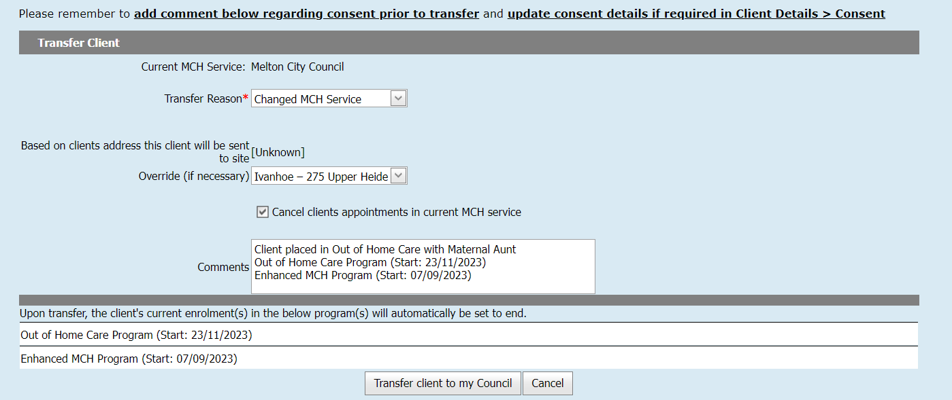
Transfers
Always transfer histories into your LGA service
Best Practice is to contact MCH service and advise of transfer and if you pulled in the wrong CDIS history
Note in the comments EMCH or S&S programs as they will close on transfer
Notes:
Careful note should be taken when transferring adults that have a current enrolment in an Enhanced or S&S program as these programs will be closed and information forfeited when transferred.
Best practice would be to have the MCH team leader contact the relevant council prior to transfer.
Best Practice is to always pull histories, never “push” or transfer a file away from your council.

