Slide 1
CDIS Universal Active List Missed Visits & Follow Up
Child Development Information System (CDIS)
CDIS Users Group (Admin)
Tuesday 6th September 11:00 am – 12:00 pm

Slide 2
Contents
Universal Active List
Sorting the Active List
Hyperlinks
Suggested Process for Missed Visit Follow Up
Bulk SMS

Slide 3
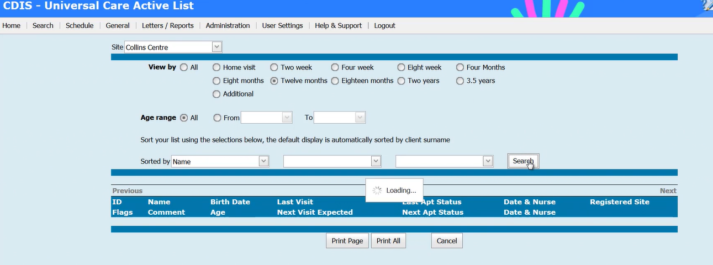
Universal Active List
Top Navigation Bar in CDIS under menu “General” is the “Universal Active List”
VIMEO - https://vimeo.com/432022192
Home screen >menu “General” >“Universal Active List
Use the Universal Active list to check for clients who are overdue for their KAS visit at a site
Choose Site > Collins Centre
Age > 12m KAS
Click > Search

Slide 4
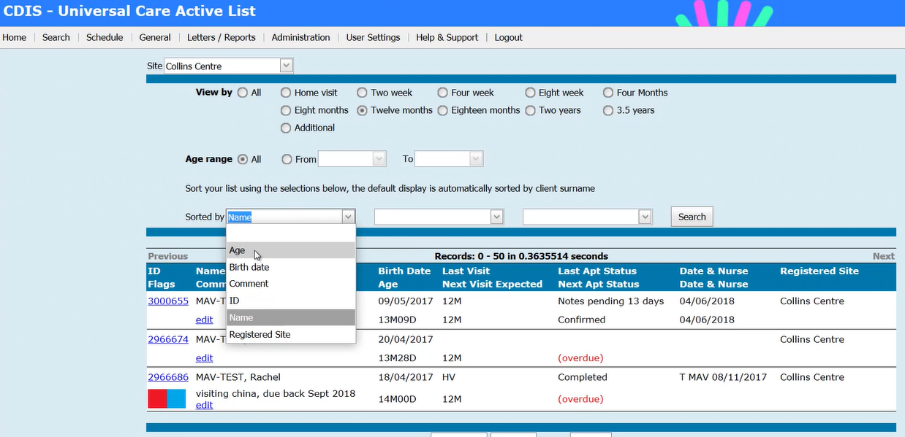
Sorting the Active List
Click on first drop down sorted by menu
Choose Age – this is usually the easiest menu to sort by.
Click Search to sort.
List of clients overdue for visit will be appear sorted by Age – oldest child will appear at top of list.

Slide 5
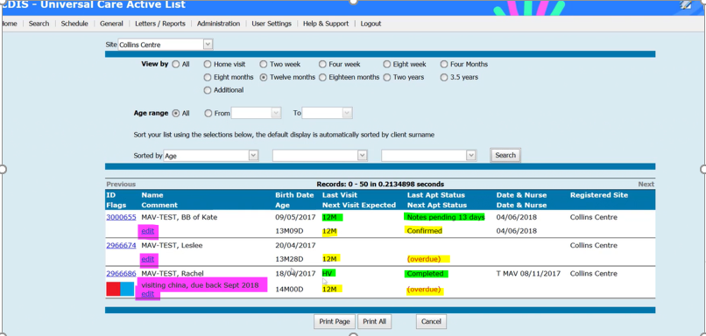
Sorting the Active List
You can then see the list of clients overdue for 12mth appt
The list will show you the age of their last visit and the next expected visit
BB of Kate is overdue for 12m KAS, you can see she has an appointment booked in the calendar – so if comes up “confirmed”
Leslee is overdue for 12m KAS – see in ref “overdue” means no appointment is booked for this KAS
The “edit” note can be used a prompt, for the person reviewing the list to be aware of something going on for the family
Rachel – we can see her Last KAS completed was the HV and there has been a service gap. AS you can see there is an “Edit note” explaining that child was in China and when she was due back.
Rachel is now overdue for 12m KAS with no appt booked
BB of Kate also has “notes pending for last appt status, this indicates the appointment remains in CDIS as not started or not cancelled, or consult opened and not completed.
The list also allows you to see if there are any flags pertaining to the child and can help you to prioritise who to contact first.

Slide 6
Scenario 1:
The child above is now nearly 11m but were not flagged as overdue as there had been an 8m appointment scheduled, but it was a cancelled as a DNA fro 8m KAS – client requires contact for new appt.
Scenario 2:
Child who is already 11m and marked as “tentative” does not come up with overdue as there is a 8m KAS booking in the past that was not attended or cancelled on 23/5/22, so notes are pending from that date (as consult was not commenced).
Scenario 3
Client who is just over 8m was a DNA/Cancelled 4m KAS. As there is no 8m appointment date, it is flagged as overdue.
Scenario 4
Child just over 8m has notes pending from a 4m KAS that was not attended or cancelled from the calendar. As there is no 8m appointment date, it is flagged as overdue.

Slide 7
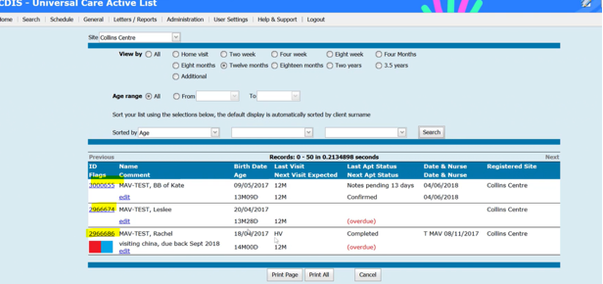
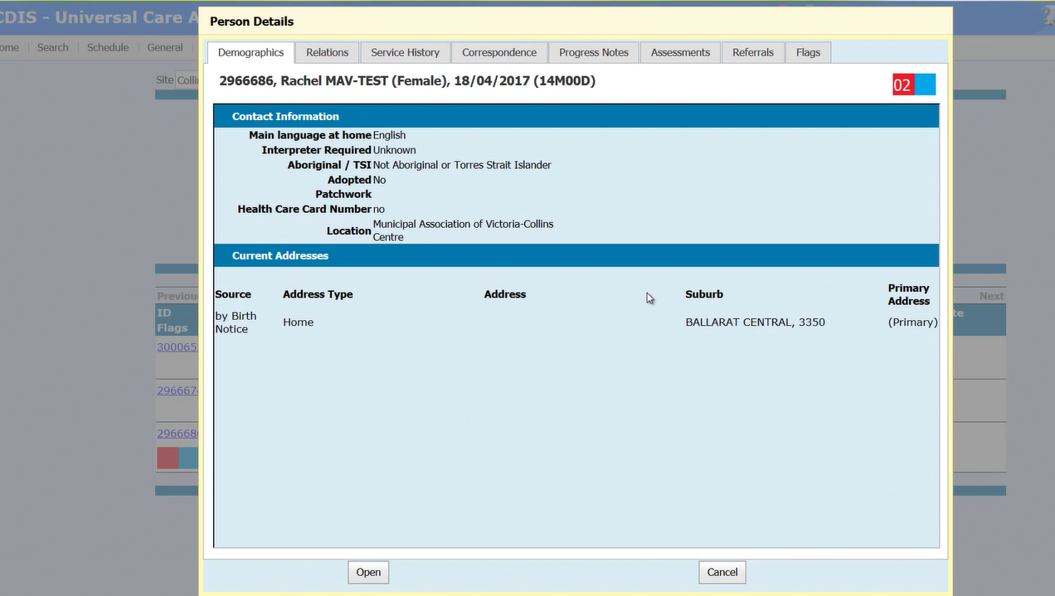
Hyperlinks
You can see that the CDIS ID is blue – this is a hyperlink to the child's CDIS record.
If you click on the Hyperlink on their CDIS ID it will create a pop up record.
From the pop up record – you can click on the tabs in the top menu to review information
Click on “Relations” for contact details to contact family re missed appointment.
The “progress notes” will be viewable from the pop up record, however these should only be reviewed by clinical staff. Clinical staff can also review any flags etc. Admin can open the full record by clicking “open” at the bottom of the screen.

Slide 8
Suggested Process for Missed visit follow up
Process LGA specific – review your own MCH service’s protocol
Suggested Admin process:
Regular monthly (at least) review of missed visits for each site/centre.
Phone call to client to book appointment
If no answer, leave a voice message.
Send a follow up SMS from CDIS if you don’t manage to speak to client.
Pop a note into the “edit” section of Universal Active list i.e. “(31/8/22 1st contact. AS), (5/9/22 2nd contact . AS) referred to nurse.
Also check parent and sibling record details for updated details such as a new phone number or address that may not have updated in each child record

Slide 9
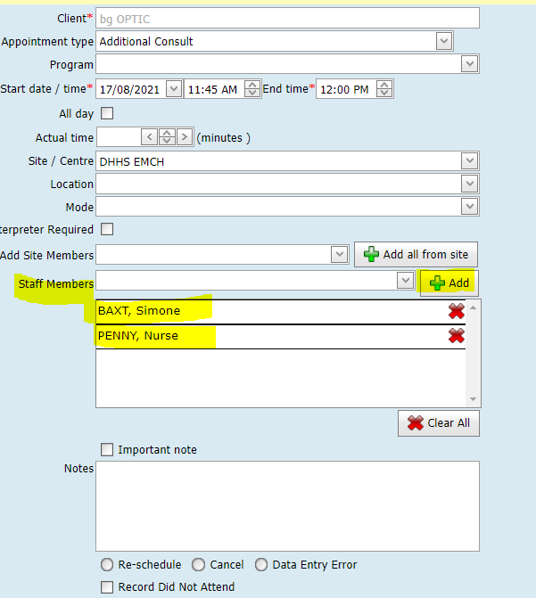
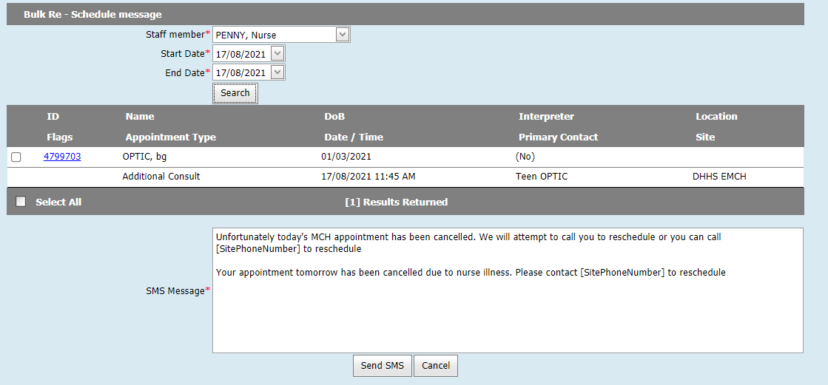
Bulk SMS
Example - client appointment
with Staff Members
The Bulk SMS screen, can be used for rescheduling for some services when calendars are scheduled with appointments for assigned staff
From the Home screen, click on the menu named Schedule > selecting Bulk SMS Re-Schedule, to open this screen.
For MCH Services whose calendars are assigned to a Site not a staff member, this screen is of great benefit if client appointments include staff members. This allows the staff member to be used in the search criteria, when/if appointments are requiring scheduling changes due to staff unavailability.
The first image highlights where staff members can be added to client appointments. The second image shows the Bulk SMS Reschedule screen and how the search can then be conducted using the relevant staff member and date range.
Example – using Bulk Reschedule screen, to search for and cancel appointments for Staff Members

