Slide 1
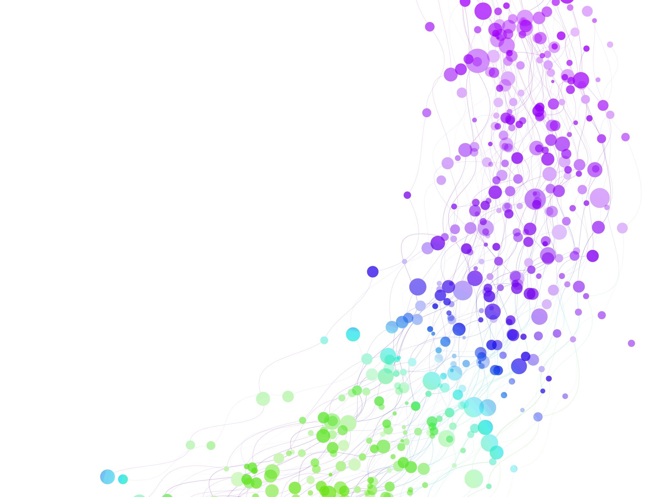
Child Development Information System (CDIS)
CDIS User Group – Clinical
December 2024

Slide 2

Agenda
Tips & Tricks
  Creating Relationships
  What does it meant when a family is highlighted green?
Follow up Topics:
  Flags
  Families not engaging with MCH how do we stop the automatic SMS reminders
  Documentation
  Recording parent/carer wellbeing
  Consent
Q&A
2025 Dates

Slide 3
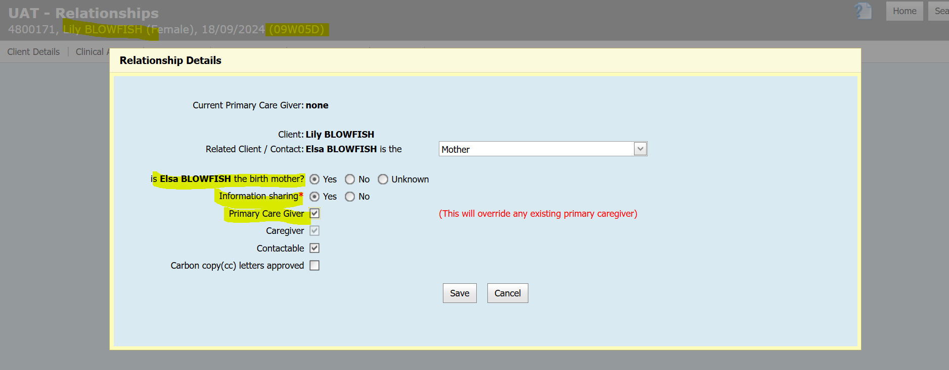
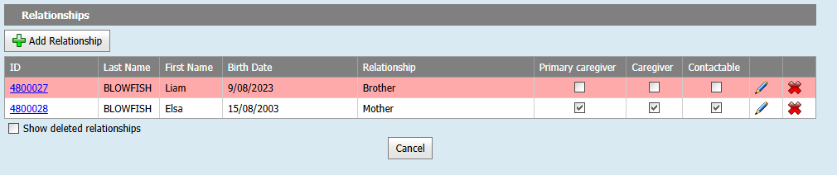
Creating Relationships
Best practice to record from the child's history
When creating the relationship the questions/status fields (highlighted yellow) are more appropriate for the adult in the relationship.
Notes:
Always confirm whose history you are in to understand the relationships

Slide 4
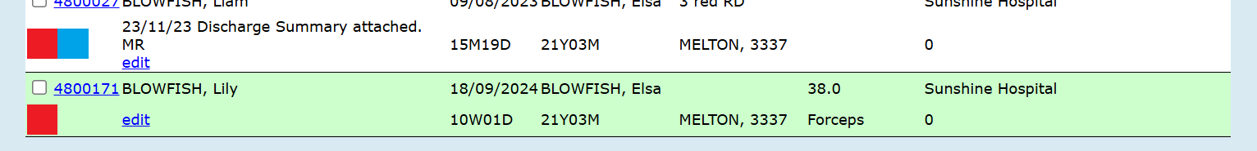
What does it mean when a family is highlighted in green in Program Active list?
Records in any screen list that are "green", are due to either:
being transferred in from another MCH service
being transferred (changed) to a different site within the same MCH service
Further notes of interest:
This colour was designed to alert users these clients are new to the site or service, and in the "list" and not to be overlooked
if they remain on the list, they will remain green on the respective "screen list" (e.g. Program Active List) for 7 days
Notes:
//Universal Active List
Will displays green if the client has at least one transfer.
This does not match the use case.
///Birth Notification List
Will display green if the client has at least one transfer.
This does match the use case.
///Programs Active List
Will display green if the client has a transfer in the last 7 days.
There are no specs in the use case for this.
Plan -
Ensure all three screens have the feature: Highlight green if the client has had a transfer in the last 7 days
Anticipated resolution will be fixed March 2025

Slide 5
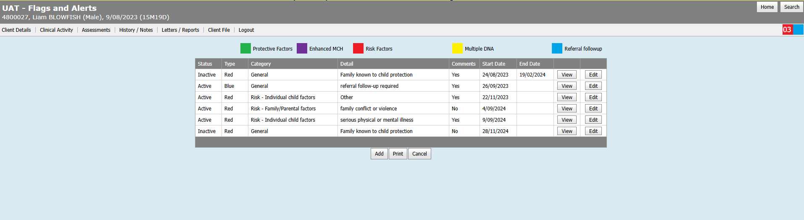
How do I generate/add flags to client histories.
Add flags via the Clinical Activity *Flags/Alerts screen this will generate the colored icon on the top right.

Slide 6

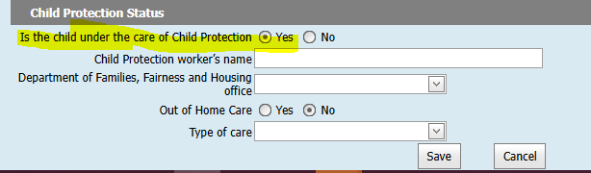
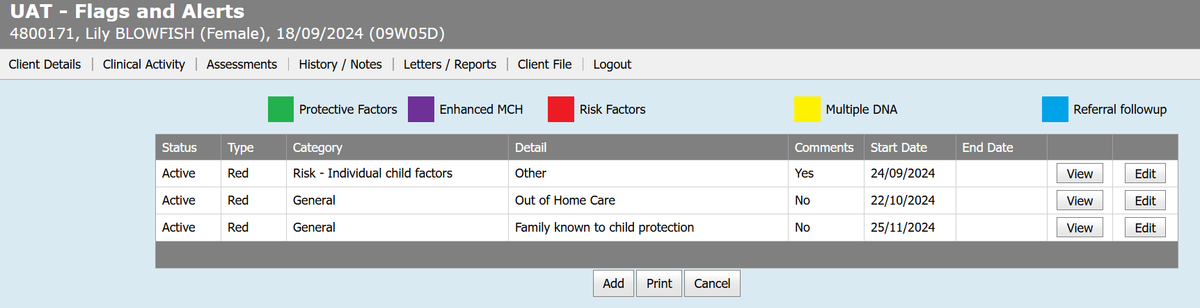
Flags
When you add a flag to a client, the respective flag colour will be added to the client’s record.
For 2 or more flags of the same colour, an incremental number will appear inside the flag.
When the flag is removed, the coloured square will change to a triangle (to alert there used to be a flag, but it is not current).
A General flag (Red) of Family known to child protection will appear on the Hx and will be listed (on the flags screen) when the question “Is the child under the care of CP” details are set to Yes, on the Update Client Details screen. Please see next slide for a current CDIS issue being fixed.

Slide 7
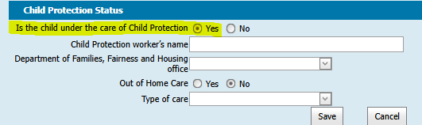
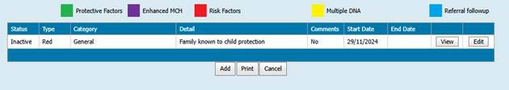
Flags – issue when creating or updating a Hx
When a client record is created, or a client record is updated (Menu: Client details > Update client details),
If the Child Protection Status question "Is the child under the care of child protection" is set to yes:
A flag is listed in the flag screen; however, the Status of the flag is “Inactive” (this should be set to “active” status)
The warning message at the top of the Client Details (Summary page) is still visible (as expected)

Slide 8
Flags – issue when creating or updating a Hx – Recommended Workaround
Edit this inactive flag, to be properly inactive by setting an end date.
  From within the client record, select Menu Clinical Activity > Flags / Alerts
  Edit the flag, setting the end date, and click Save to complete.
Manually add another flag, clicking Add, and select the following from the drop-down options:
  Category: General
  Details: Family known to child protection
  “Start Date” left as default or edited as required, and don’t enter an “End date”
  Comments added as required and click Save to complete.
DRA are working on resolving this, and it is expected this will be resolved in the first few months of 2025.

Slide 9
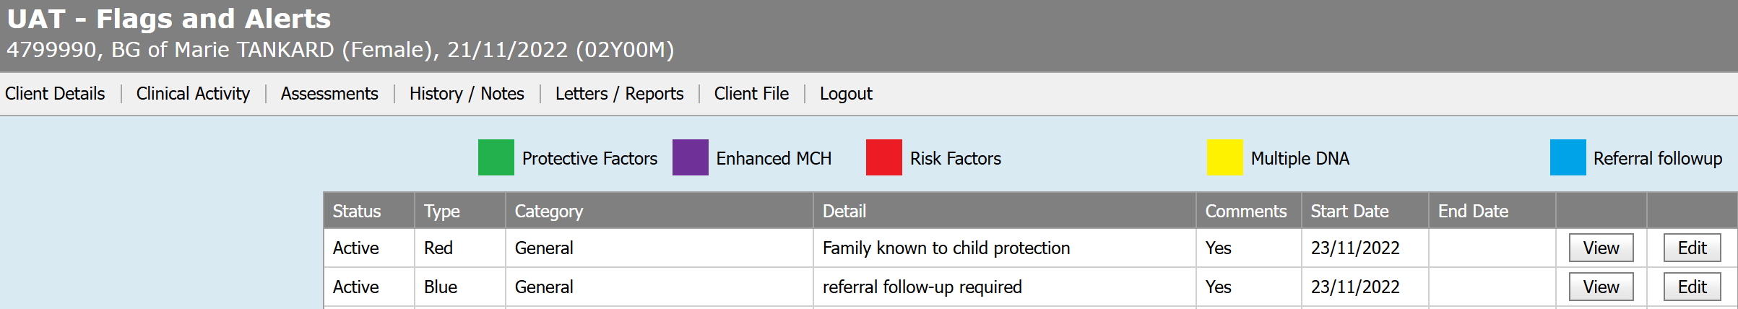
Reviewing & Updating Flags
All MCH clinicians' responsibility to review and update flags.
If flag no longer applicable – please end date.

Slide 10
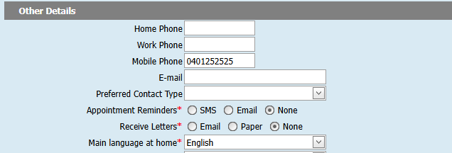
How do we manage families who choose not to engage with MCH and stop appointment reminders?
To manage families who have chosen not to engage with MCH you can do the following:
Via client record>Client details>Update client details

Slide 11
Importance of Completing Documents
Responsibilities
MCH nurses have responsibilities under AHPRA and Nursing and Midwifery registration
Midwifery-Competency-Standards-January-2006.PDF
Competency 1: Legal and professional practice clearly states that documentation is to be:
  Contemporaneous (existing, occurring, or originating during the same time)
  Comprehensive
  Logical
  Legible
  Clear
  Concise
  Accurate
Why Documentation Matters
It is a Health Record
Multiple practitioners may be involved with the same family/child.
Records need to be transferable when families move to a different municipality.
Documents are carefully examined in case of claims or litigation.
Recommendations
Identify the practitioner (and role) recording the notes
Record recommendations to parents, referrals and outcomes
Be familiar with internal policies, MCH Guidelines and Documentation Standards
Ensure notes are saved into CDIS at the end of each day
Notes:
Completing KAS notes is vital for tracking child development, ensuring early intervention, providing personalised care, empowering parents with information, maintaining comprehensive health records, supporting research, upholding legal and ethical standards, enhancing child wellbeing, and promoting accountability in maternal and child healthcare. These notes are essential tools in promoting the health and well-being of children and families.
All MCH Nurses have responsibilities to maintain accurate records and documentation as part of their Australian Health Practitioner Regulation Agency (AHPRA) and Nursing and Midwifery Board of Australia registrations.
Why is documentation so important ?
Multiple practitioners seeing same family/child
Transfer of file where family moves to a different municipality
Documents will be examined carefully where there is a claim/litigation.
Recommendations
Information to be clear, contemporaneous and complete
Identify the nurse recording the information clearly
Have a clear protocol in place where student nurses enter information which is then checked by supervising nurse
Record all recommendations provided to parents
Record all counseling and referrals given and any discussed.
Record follow up of referrals, recommendations and outcome
Be familiar with council’s internal policies, MCH Guidelines & Documentation Standards
It is important that all notes are saved into CDIS at the end of each workday to ensure they are available to all practitioners working with the child/family.
Also applies to allied health clinicians.

Slide 12
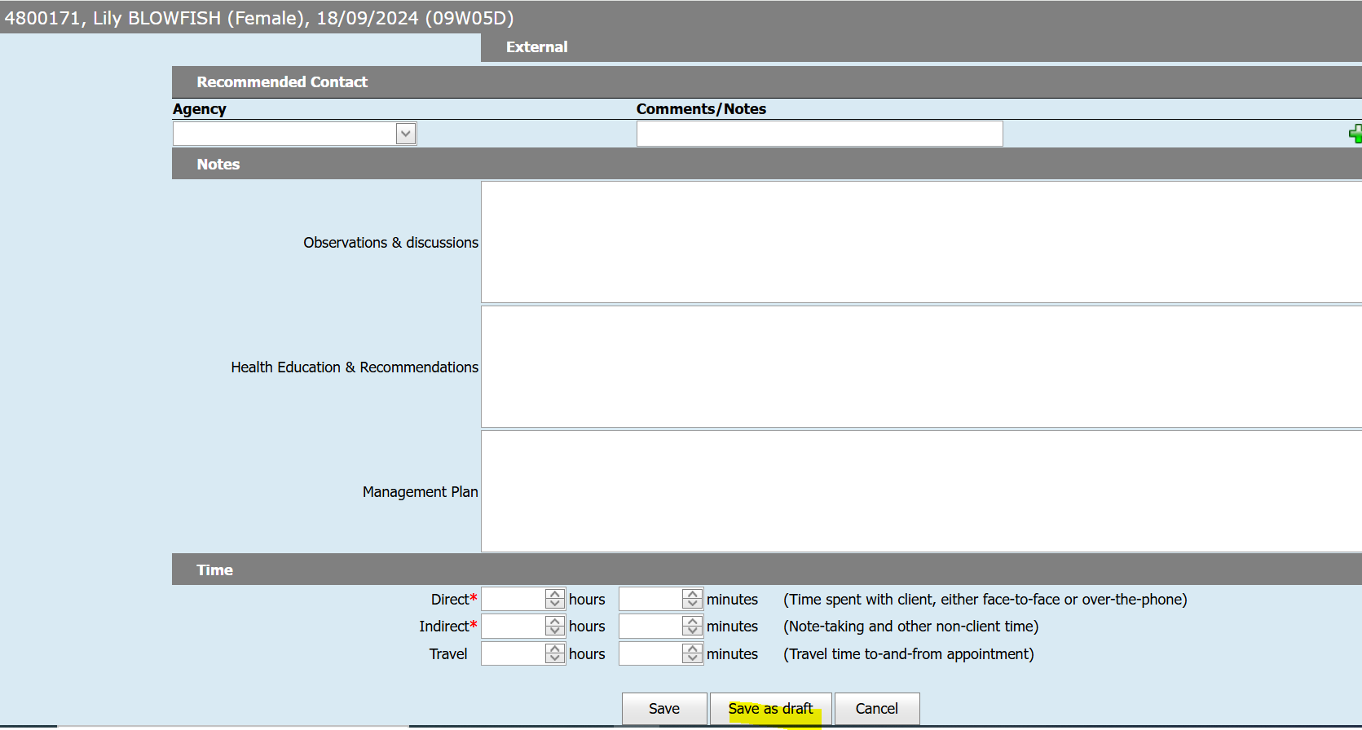
Consultation notes
Save as draft can be used during the day but at the end of the day best practice is to save the consults.
Notes:
Whilst CDIS has the Save as Draft feature our professional legal obligation is to complete notes at the end of each working day.
The risk with the draft feature is:
The consult will sit in the incomplete consults
Not visible in the body of the clients' notes – other clinicians will not see them. If they enter the draft consults, they could sign them off or alter the notes.
That you can go in and alter the draft notes the next day or next week and if there is a child injury or FV and you are called to court then your notes will be dated at a different date other than the date of the appointment. Hard to give credible believable evidence if you have to explain that the draft notes are changeable until you save them.

Slide 13

Recording of maternal wellbeing at 4wk KAS or any KAS
Where are you storing your iCope reports/EPNDs?
Best Practice is to record and attach any sensitive information related to an adult in that specific adult record.
Record in the child's history if the impact of the sensitive information is impacting the wellbeing of the child when further action is required.
Notes:
Talk to this

Slide 14
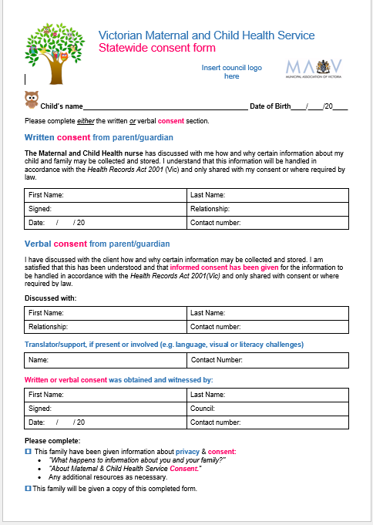
Consent
Consent needs to be obtained for the collection of health data for the state-wide MCH Victorian MCH Service. Ensuring families understand how their information will be collected, stored, used or disclosed in accordance with law.
Process for consent tends to be LGA specific
If obtaining “written consent” this should be upload into CDIS, verbal consent is also acceptable and should be recorded as such in CDIS.
Consent must be recorded under all clients who are engaged with the MCH service within CDIS.
Ticking consent at the bottom of the Pregnancy & Delivery screen under History/Notes is not adequate. This is consent for the home visit.

Slide 15


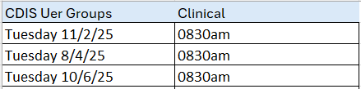
2025 CDIS User Groups – Clinical

